Slide 1










MSC COMPUTATIONAL SCIENCES THESIS DEFENSE
VICTOR PIASKOWSKI
UNIVERSITY OF AMSTERDAM
VRIJE UNIVERSITEIT AMSTERDAM
DR. MATTI GRALKA

Slide 2
30%
daily marine bacteria death due to phages
Important role in nutrient turnover and bacteria fitness
Notes:
Give introduction to what I am studying, why I am studying, implications of what I am studying

Slide 3








Mathematically Modeling the Interactions Between Phages, Bacteria, and the Environment
RQ1
RQ2
How do phages impact community dynamics in complex microbial communities?
How can you effectively model and interact with any pxbxr system?
Notes:
This report is less about finding new biology on phages, or inventing new research, or gaining more knowledge on dynamics, but more about creating a tool that can allow others to do the research with their own ODEs and parameter data.
I later show some example graphs using the tool I created.

Slide 4









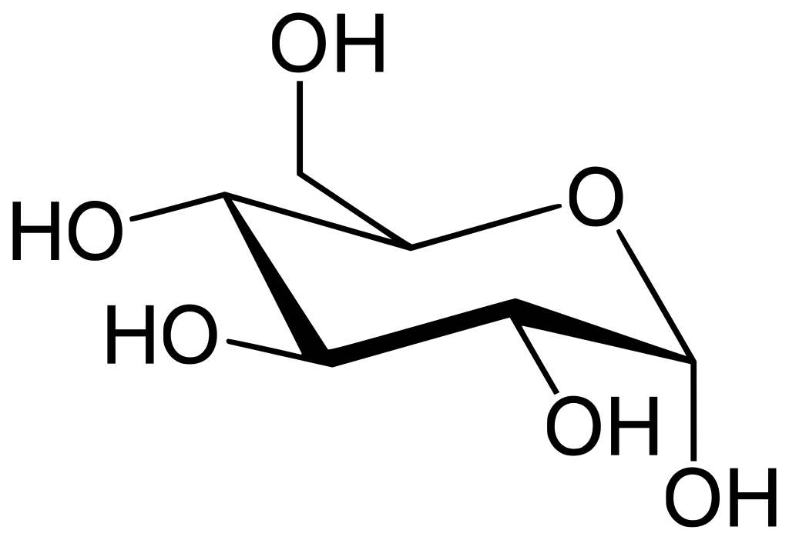
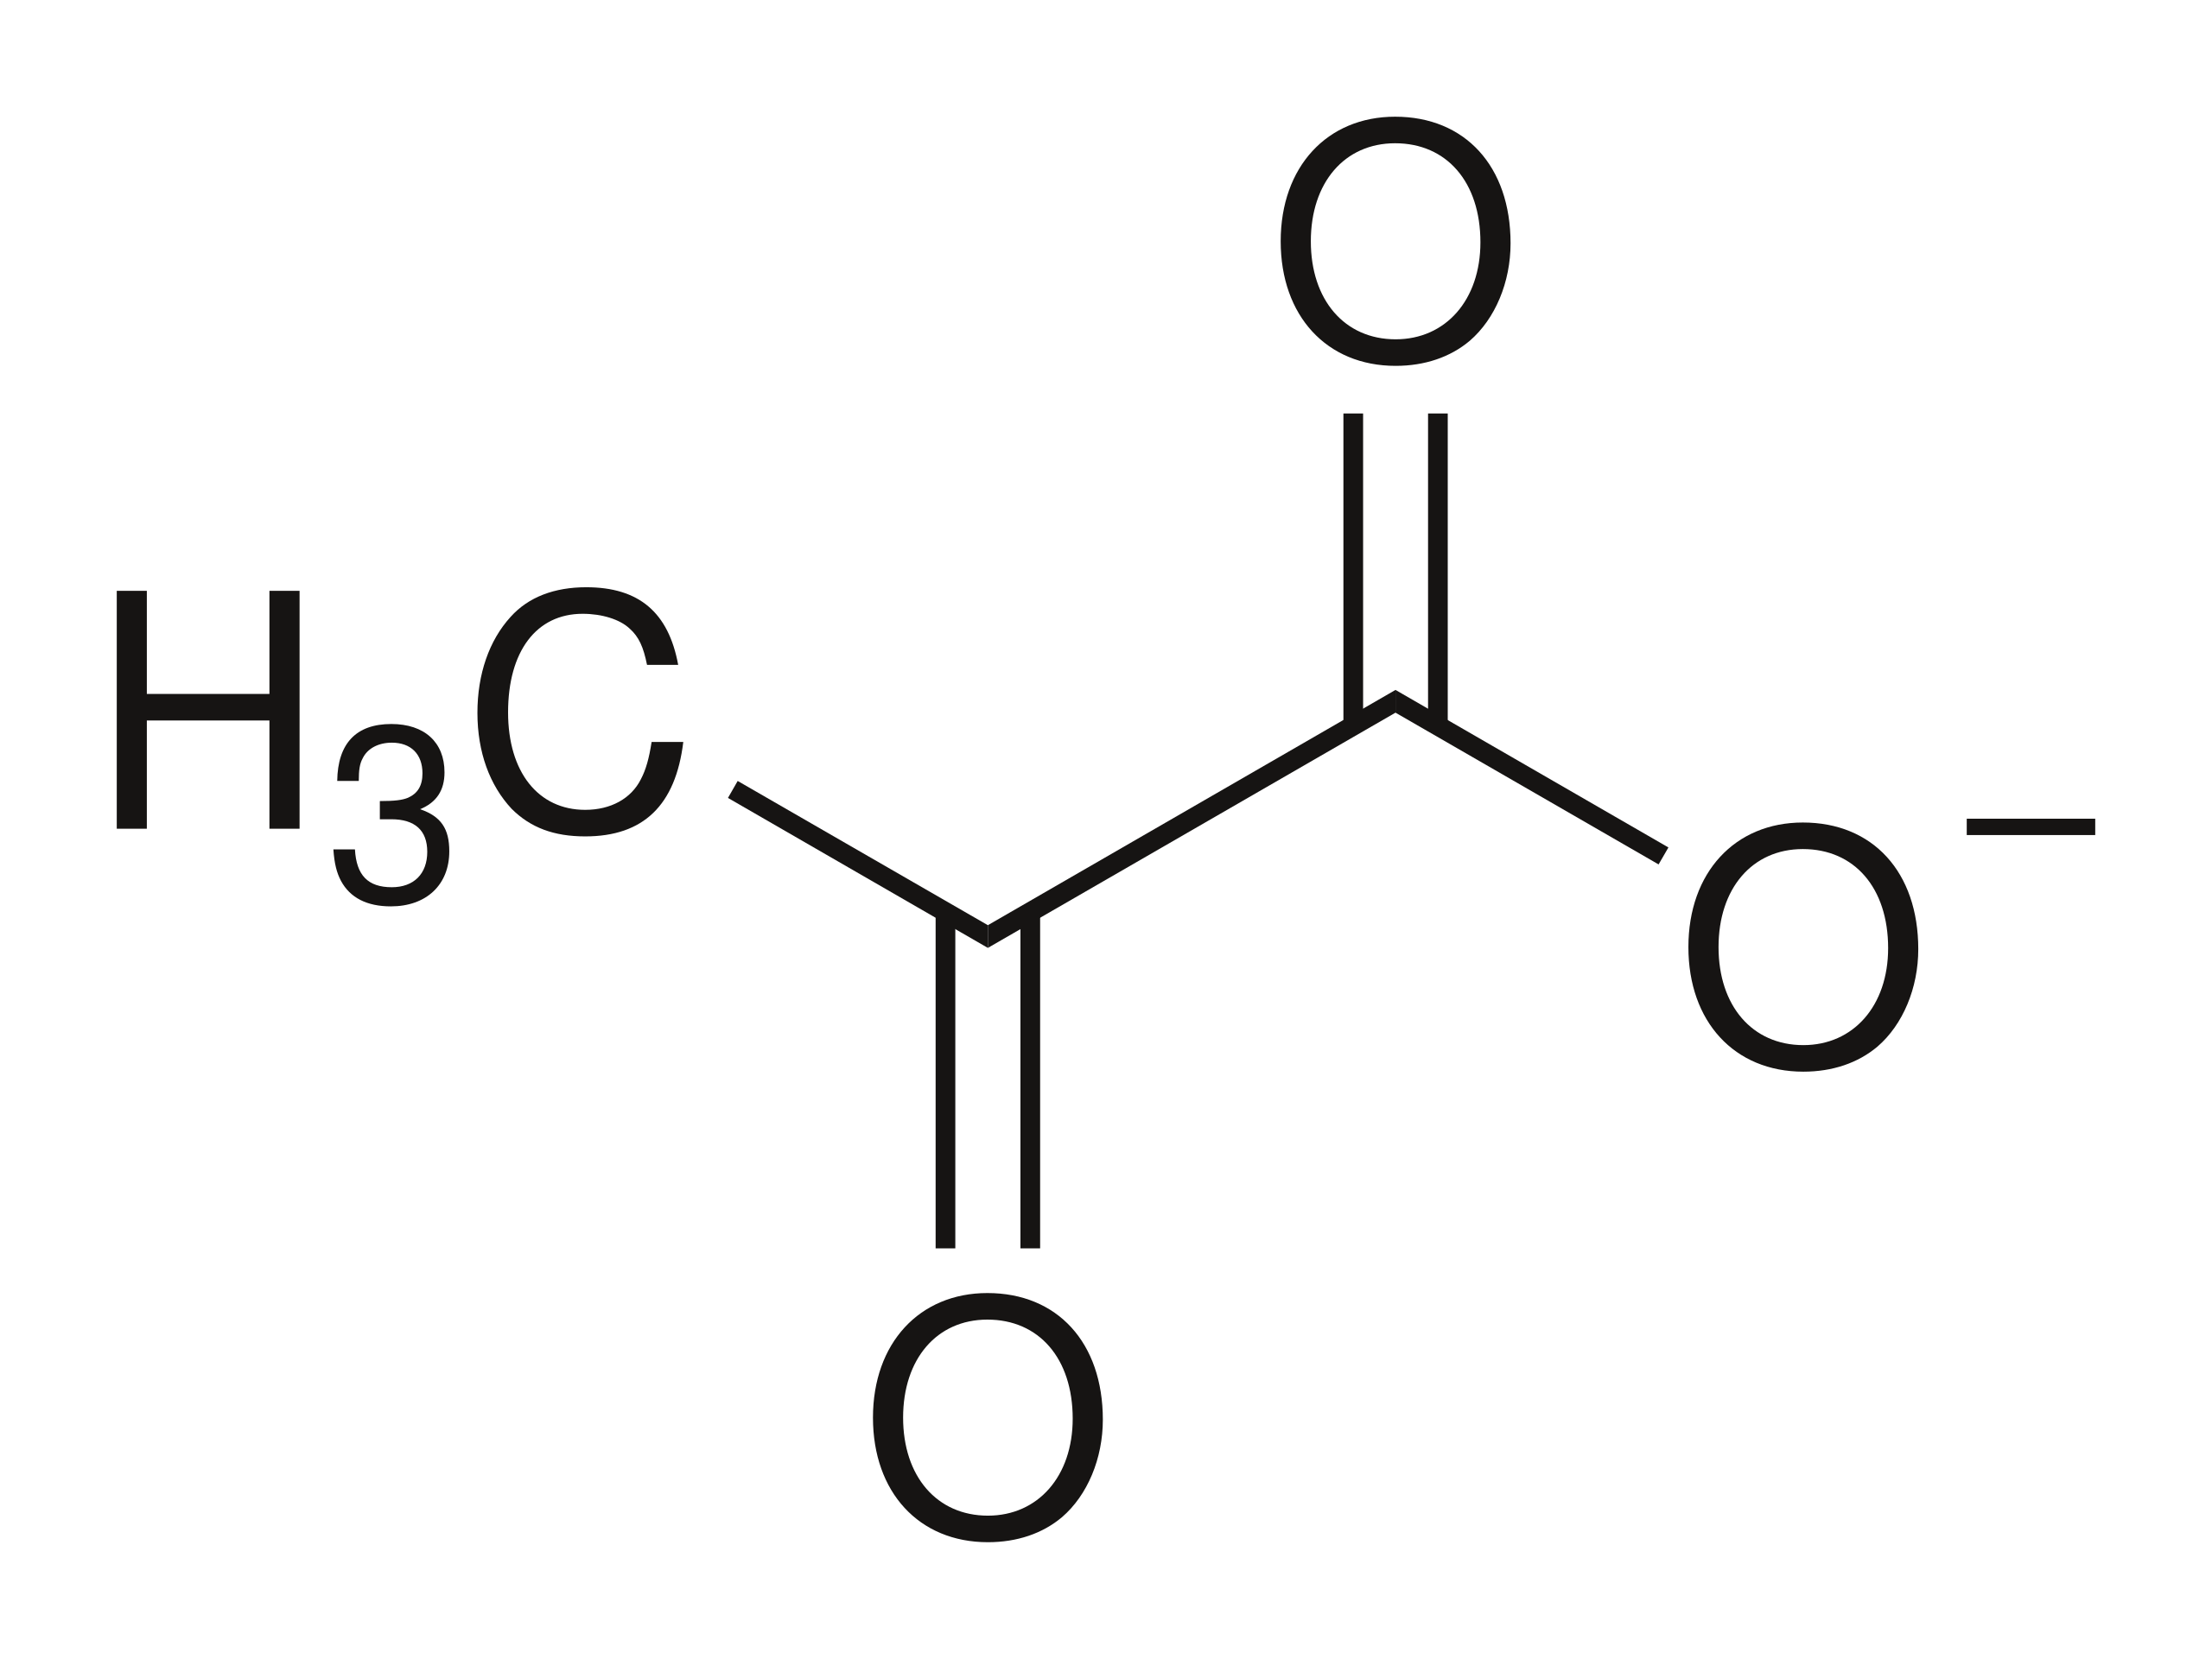


PROBLEM
x100
Notes:
The problem is that in real communities (gut, ocean, dirt, etc) there are numerous interactions between phages, bacteria , and resources.
There can be hundreds of bacteria, phages, and resource sources.
There are environmental factors, like water/washin and washout, acidity and harsh chemicals, UV, temperature.

Slide 5





CHALLENGE
Current models focus on small systems
Niche or specific situations
Limited flexibility in model setup
Varying or unknown model and input

Slide 6

ANSWER
Flexible simulation framework
Network representation
Model states
Varying complexities
Easy to set up
Interactive

Slide 7



PHAGES AND ODE MODELS

Slide 8

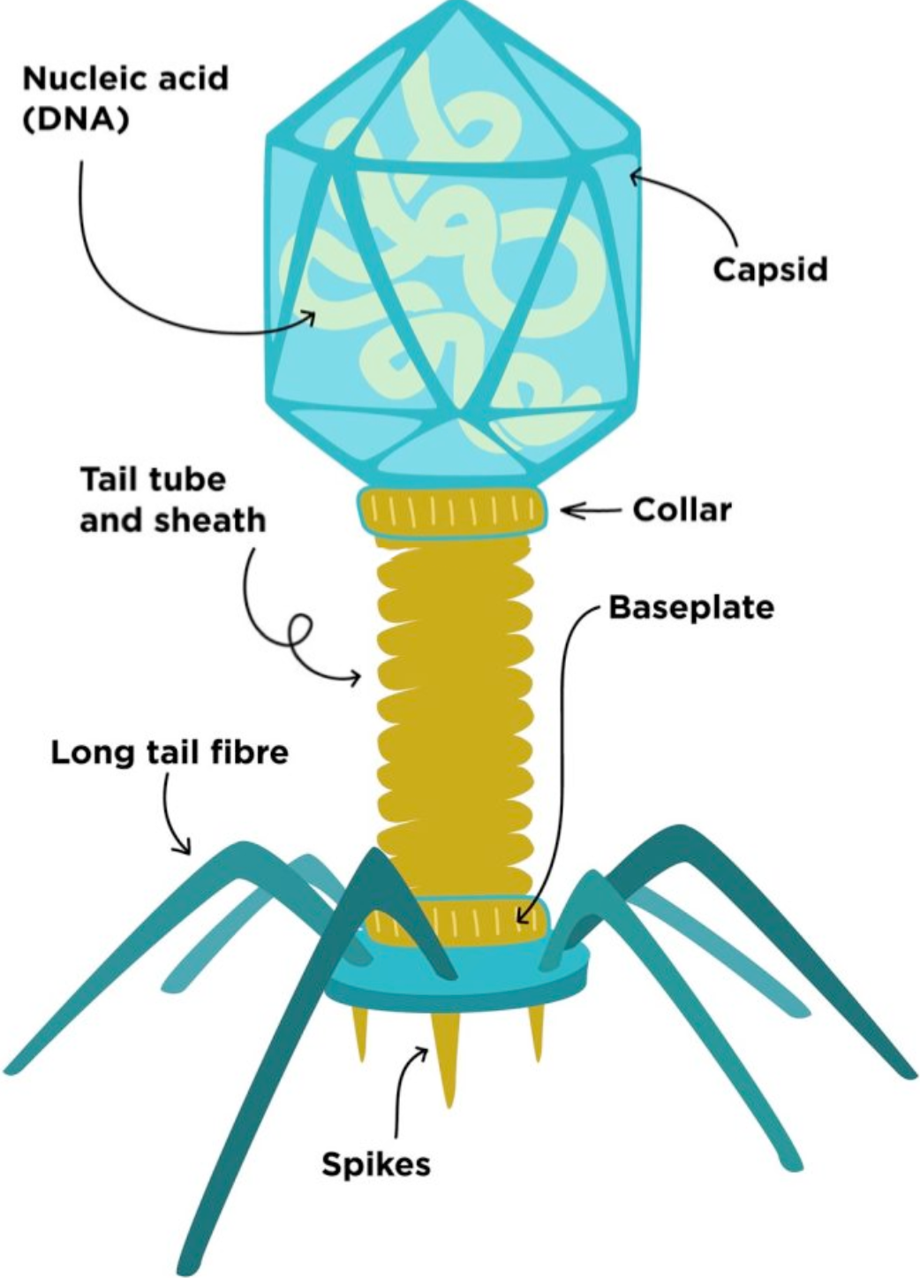
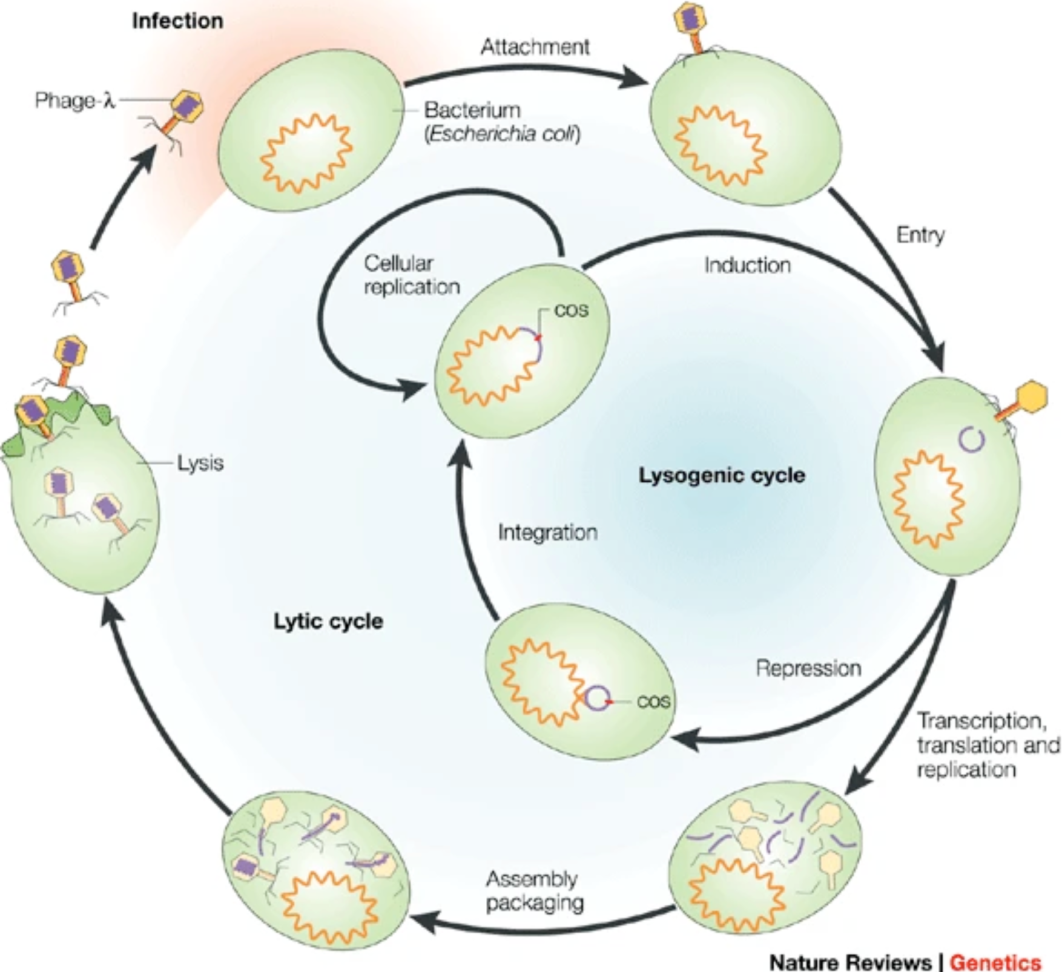
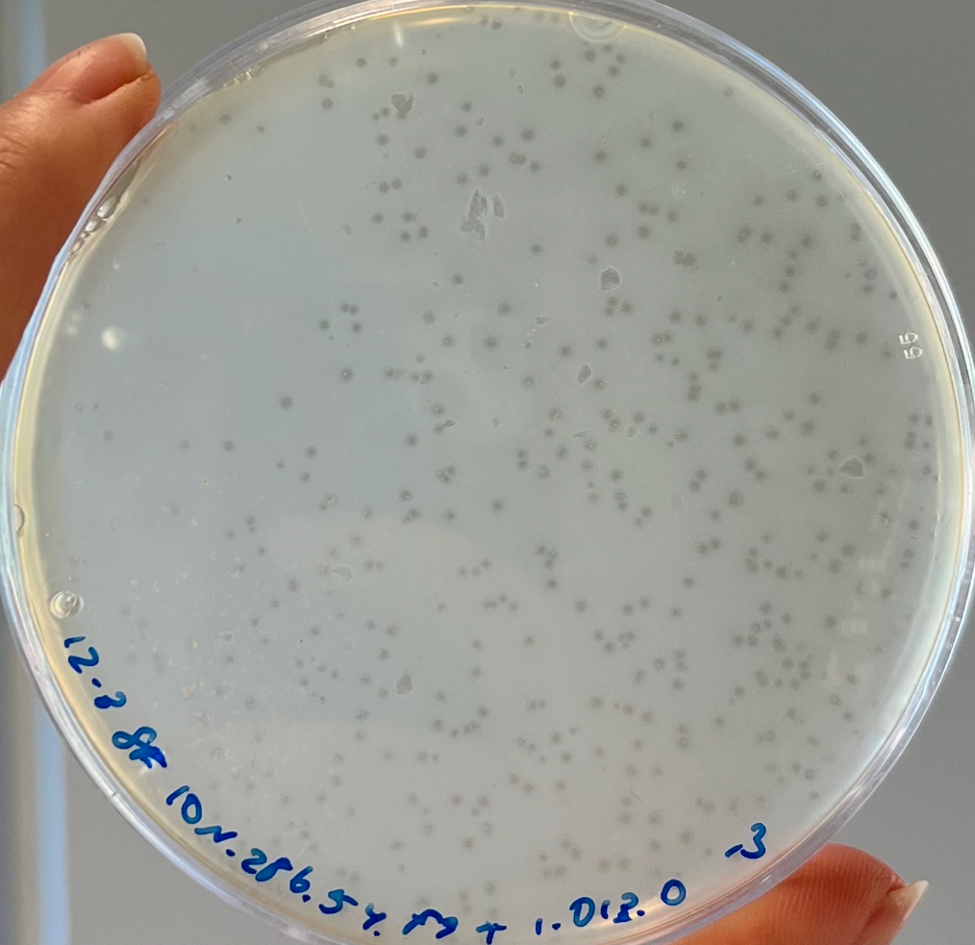
Phage Biology
27-190 nm
Infect, Lysogenic, Lytic, Release
Phage Plaques
Notes:
This is how a phage looks like, this is how they work, the life cycle, then this is a real life result.

Slide 9

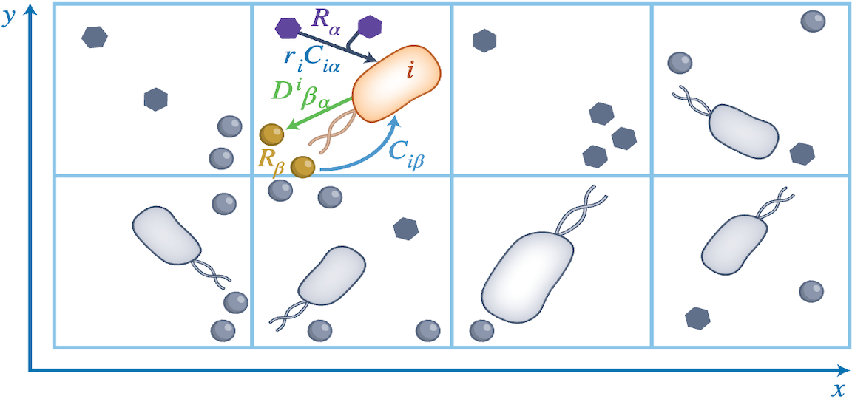
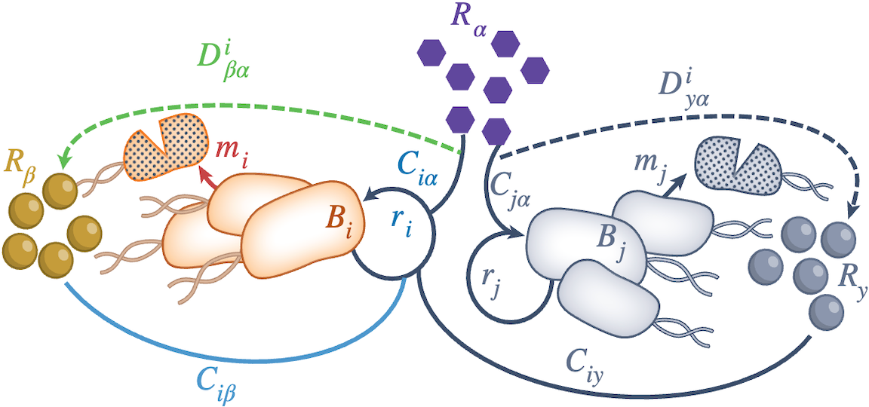

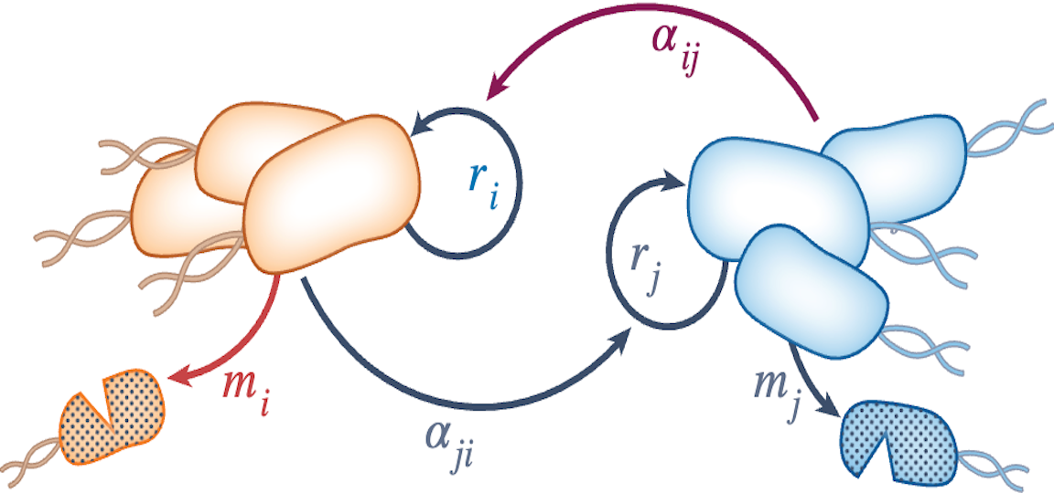
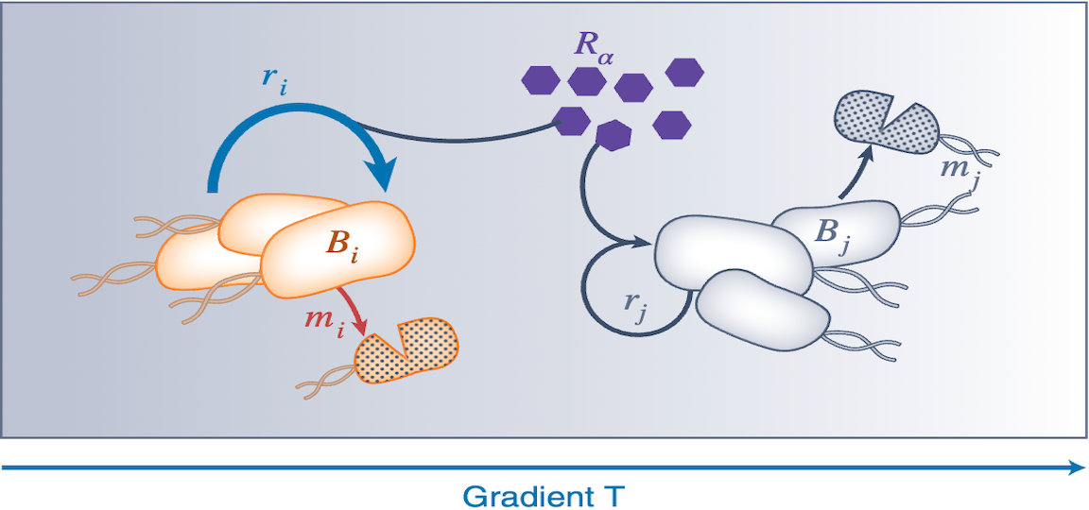
Different Models
Agent Based Model
Consumer-Resource Model
Spatial vs. Non-Spatial Models
Explicit vs. Implicit Resource Consumption
Individual vs. Population Based
Spatial, Explicit, Individual
Non-Spatial, Explicit, Population
Trait-based (PDE) Model
Lotka-Volterra Model
Spatial, Explicit, Population
Non-Spatial, Implicit, Population

Slide 10
Parts of a Phage-Bacteria-Resource ODE Model
Bacteria consume resources
Bacteria become infected
Bacteria go through an infection process
Bacteria release phages
Phages adsorb to bacteria

Slide 11
General Phage-Bacteria-Resource ODE Model Structure
Resources = –consumed + released* + washin* – washout*
Uninfected Bacteria = grow – infected – washout*
Infected bacteria = infected – die – washout*
Phages = burst – adsorbed – washout*
Bacteria consume resources
Bacteria become infected
Bacteria go through an infection process
Bacteria release phages
Phages adsorb to bacteria
* = optional

Slide 12
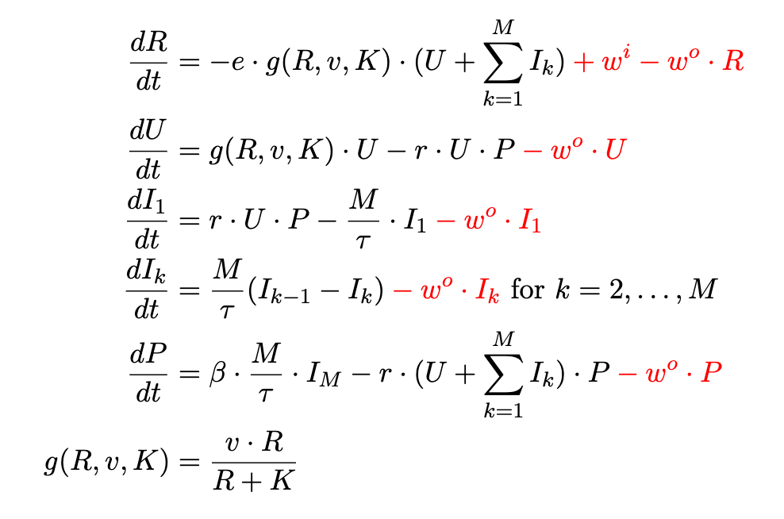
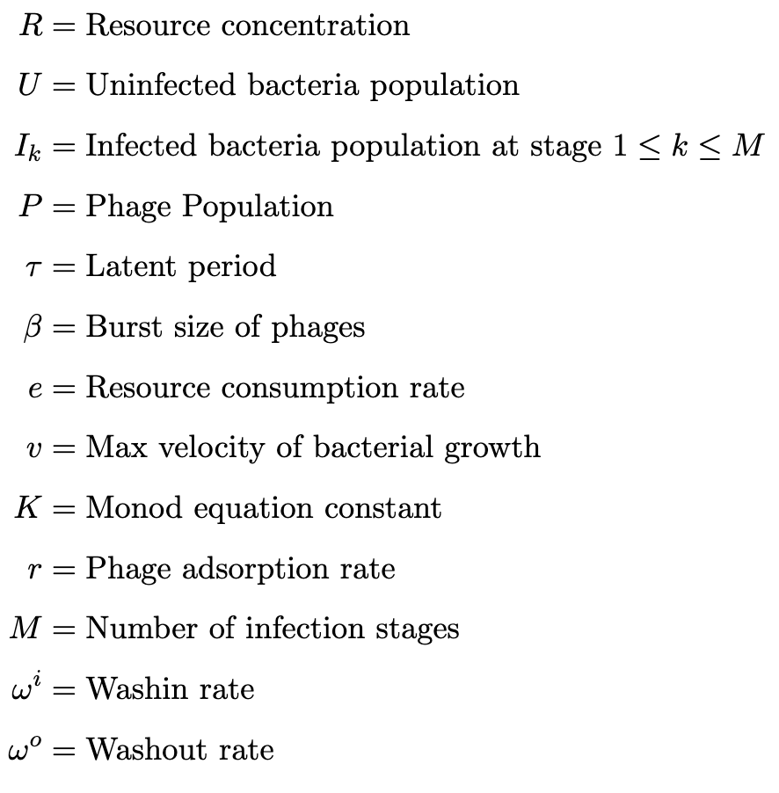
Golding Model
Bacteria consume resources
Bacteria become infected
Bacteria go through an infection process
Bacteria release phages
Phages adsorb to bacteria

Slide 13


DASHBOARD

Slide 14
Simulation Flowchart

Slide 15
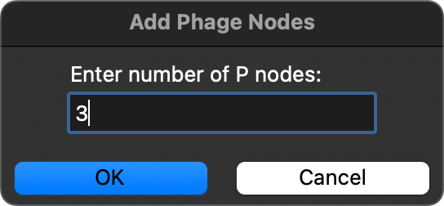
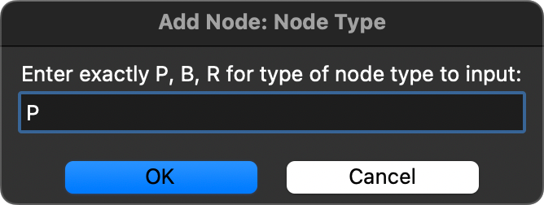

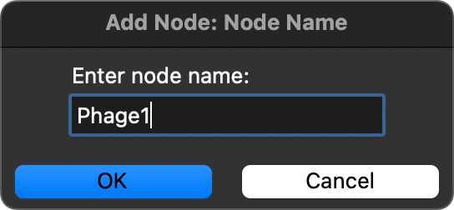
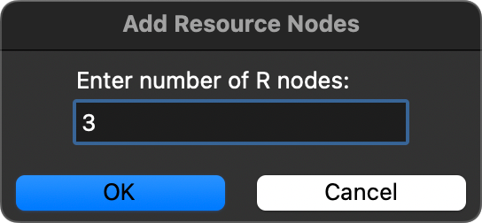
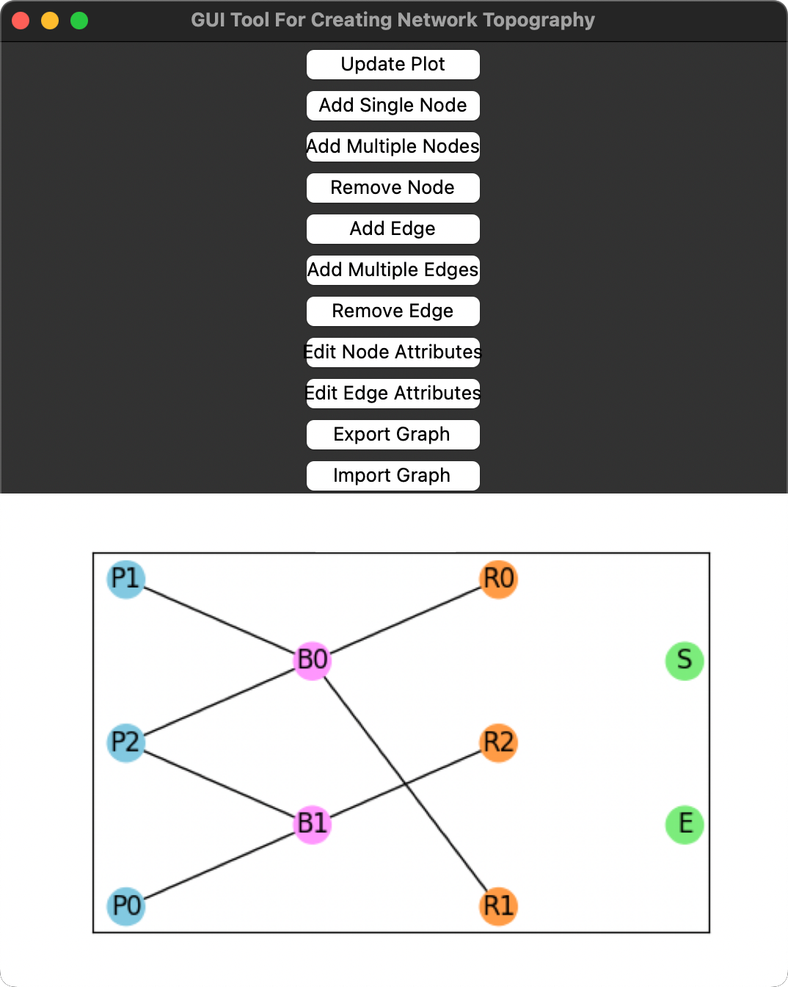
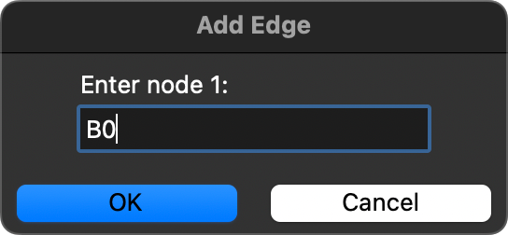
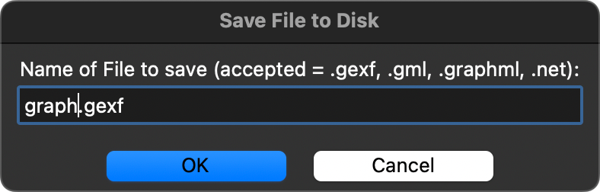
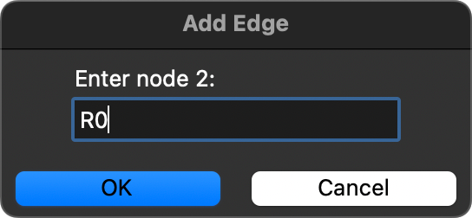
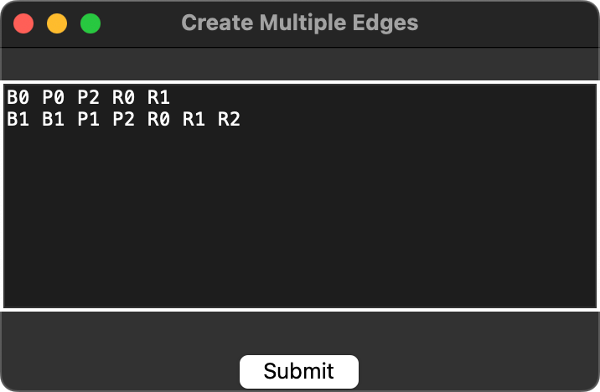
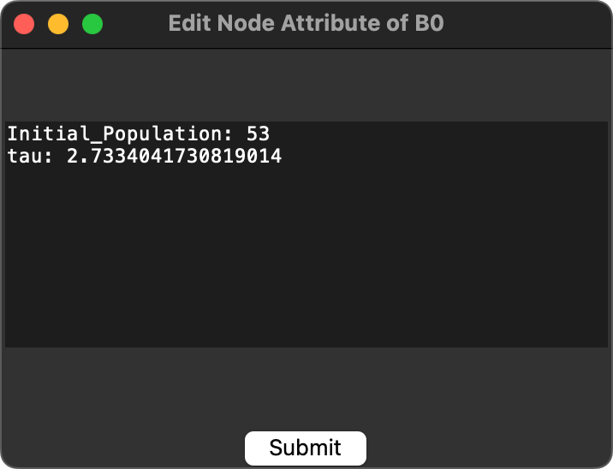
GUI Tool

Slide 16
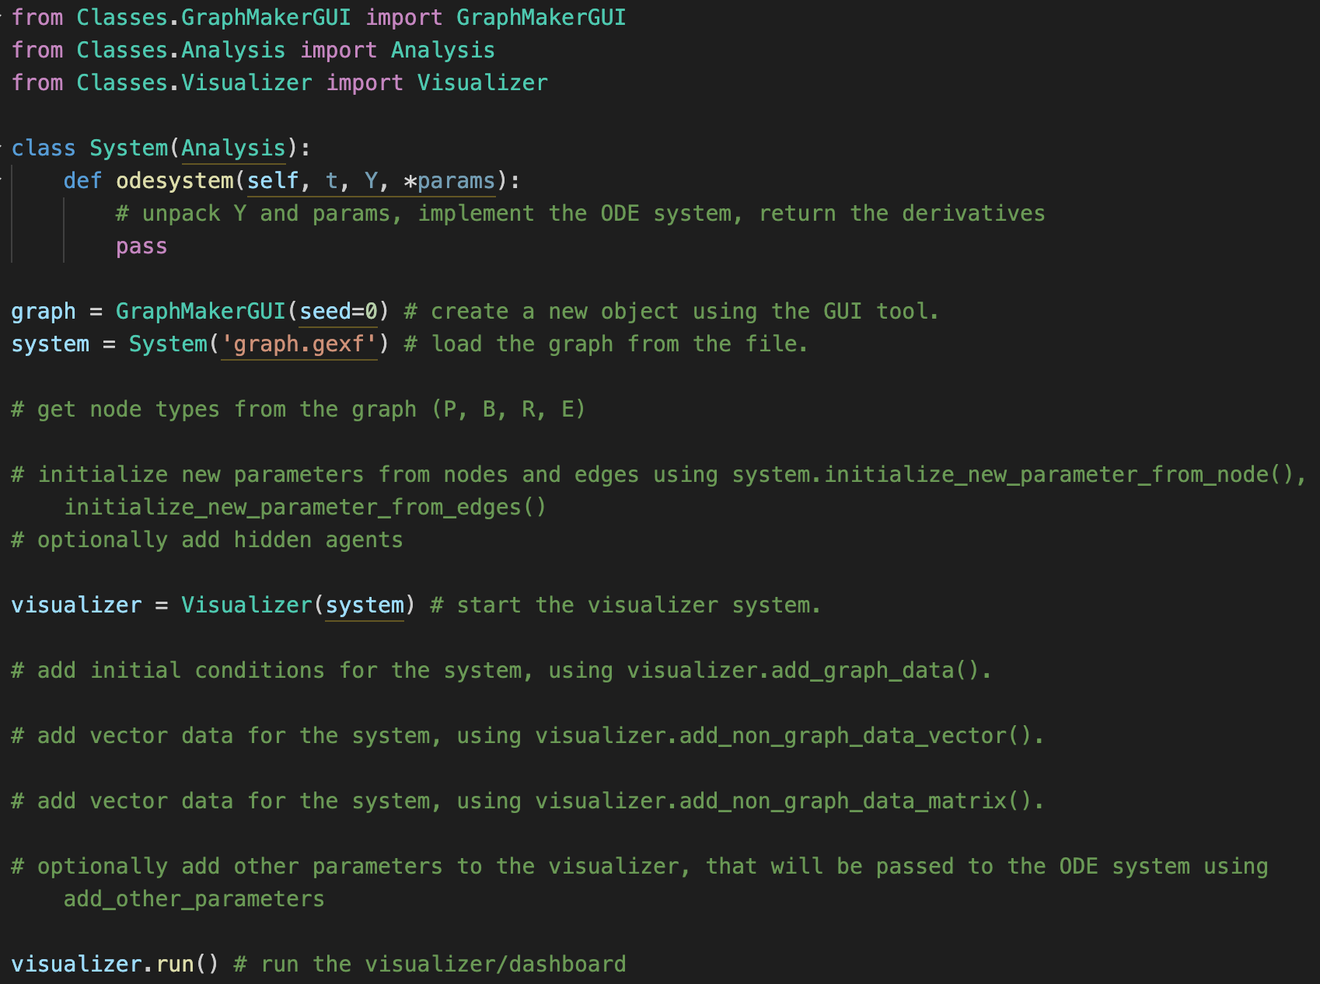
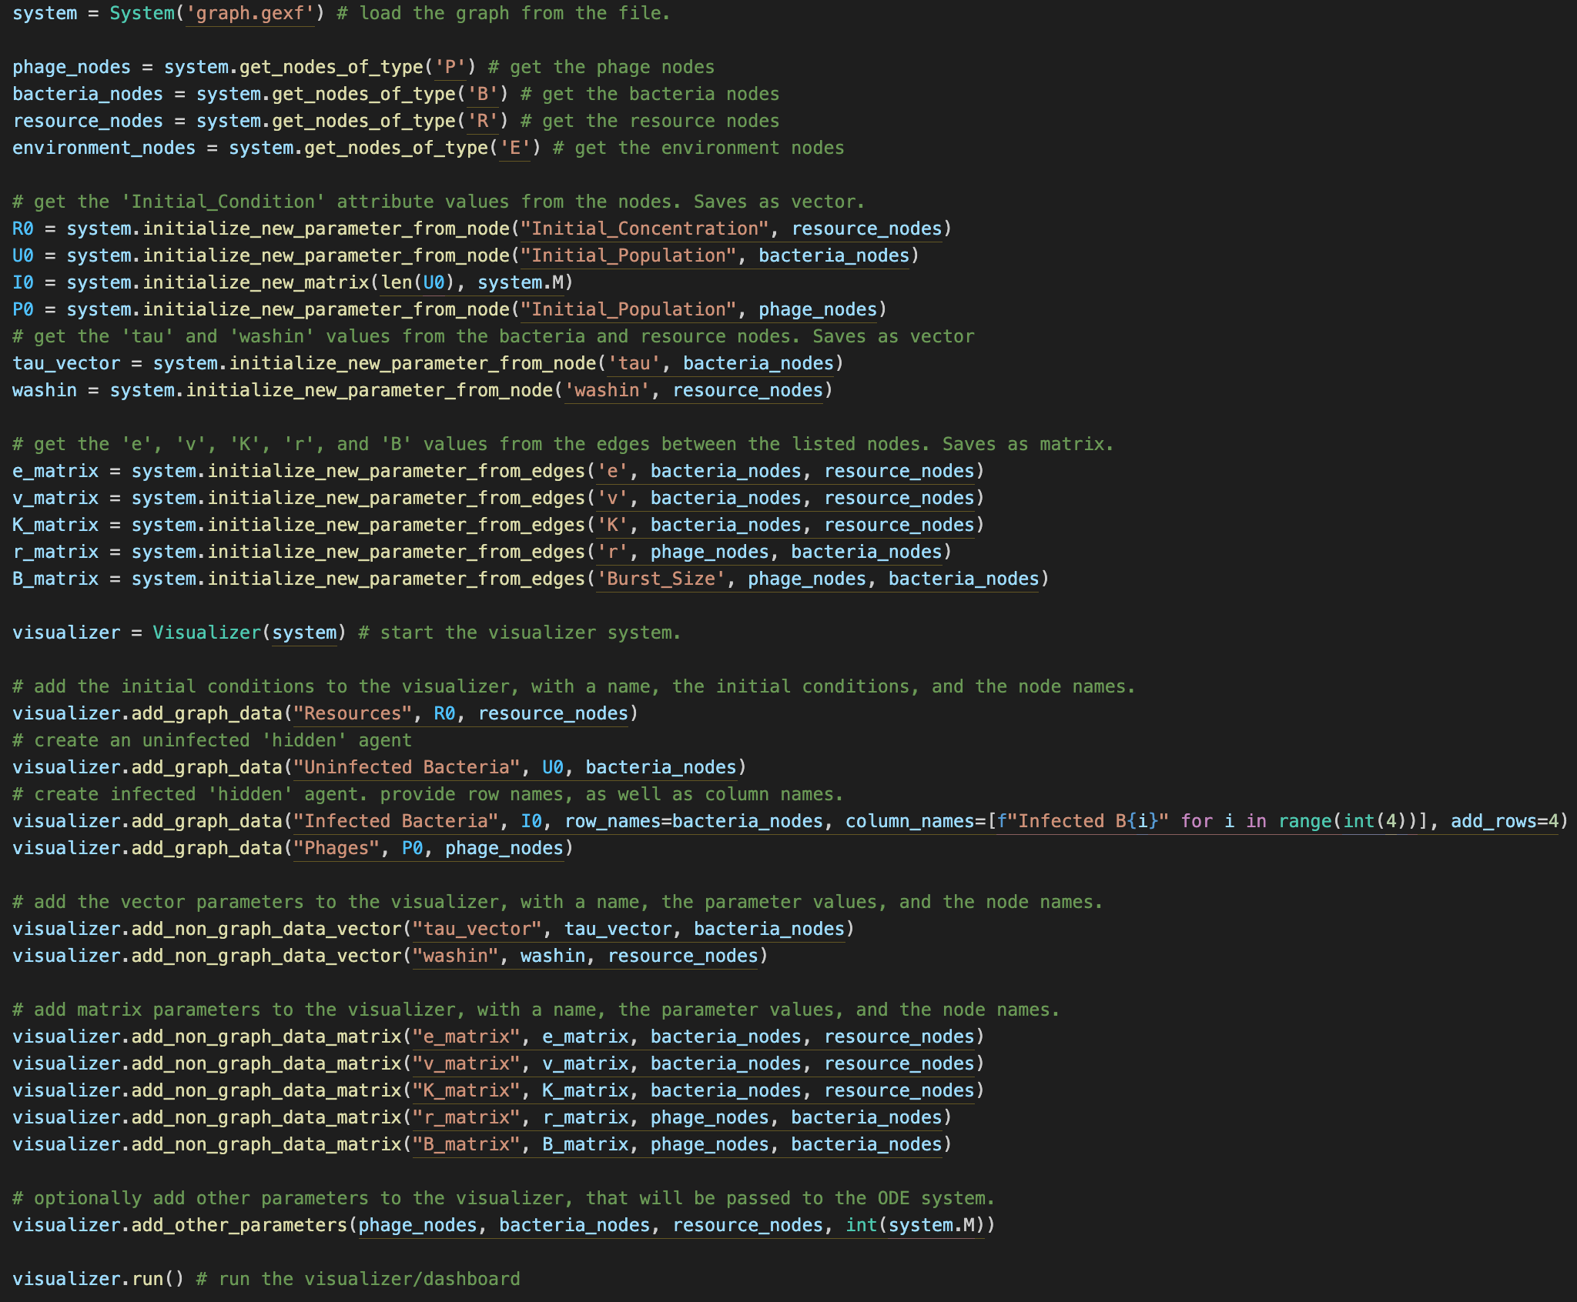
Running the Framework
Not fully automated, “manually” enter data
Low-code, boilerplate-like code
ODE code implementation

Slide 17
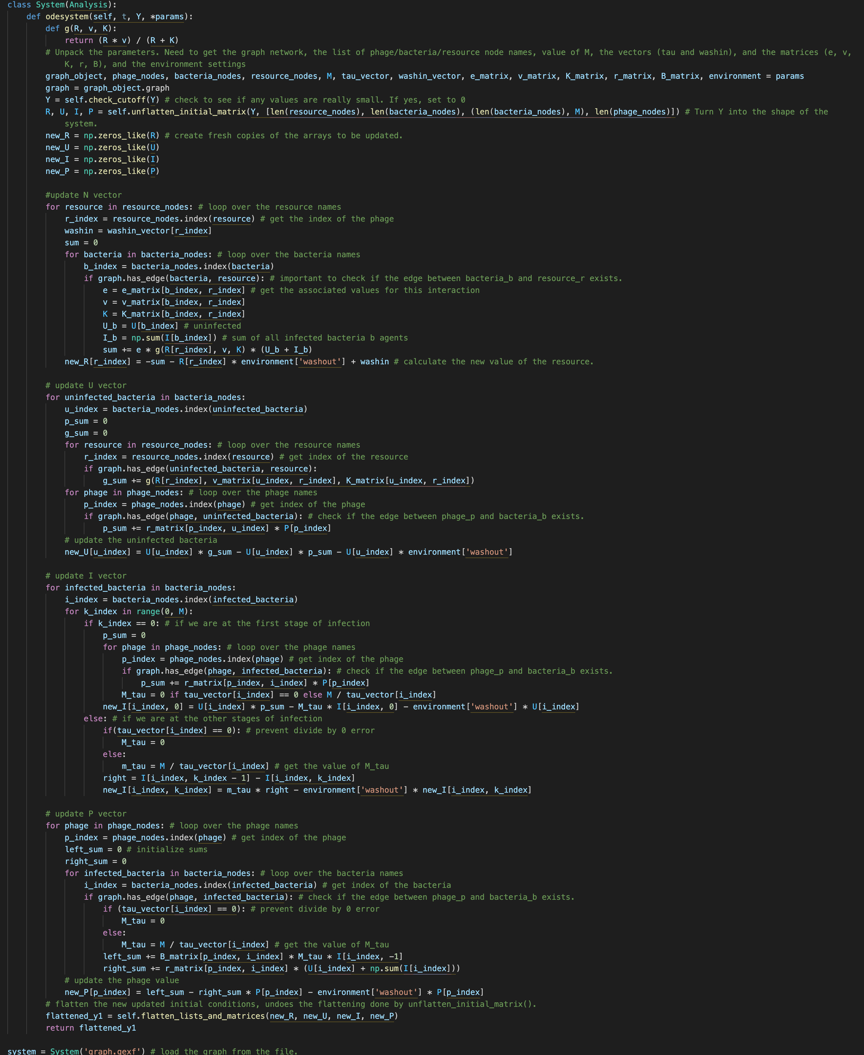
ODE Code

Slide 18
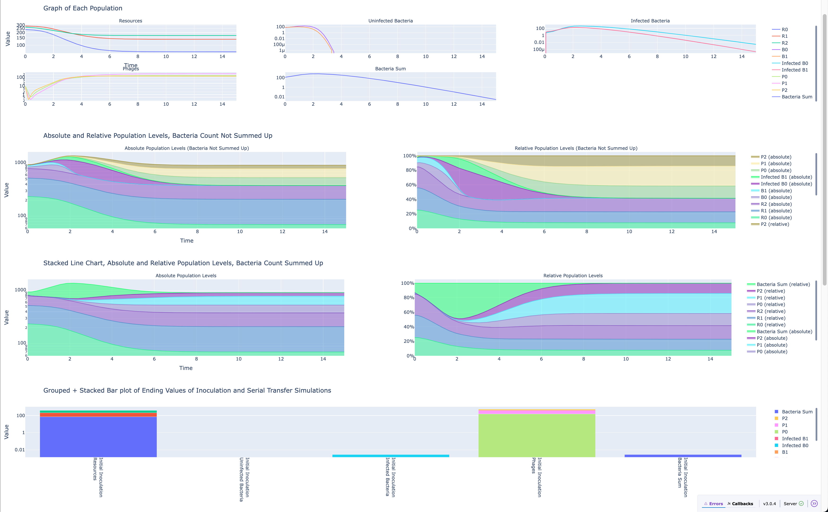
Dashboard – Plot Basic Graph

Slide 19
Dashboard - Interactivity
Interaction is forefront
Selectable dropdowns
Change axis-scale
Run Serial Transfer in Advanced Analysis
Change parameter values and settings
Decide specific parameter values or range of values
Every graph element is hoverable – displays parameter condition, compare values

Slide 20
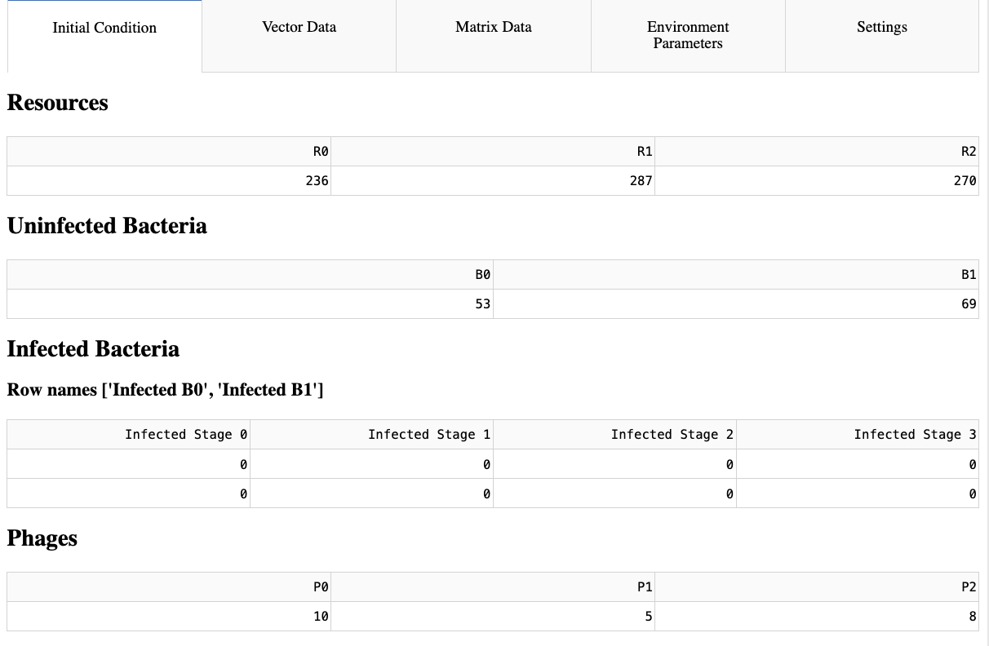
Dashboard – Edit Parameters

Slide 21
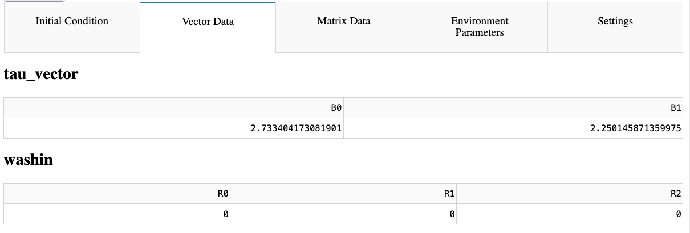
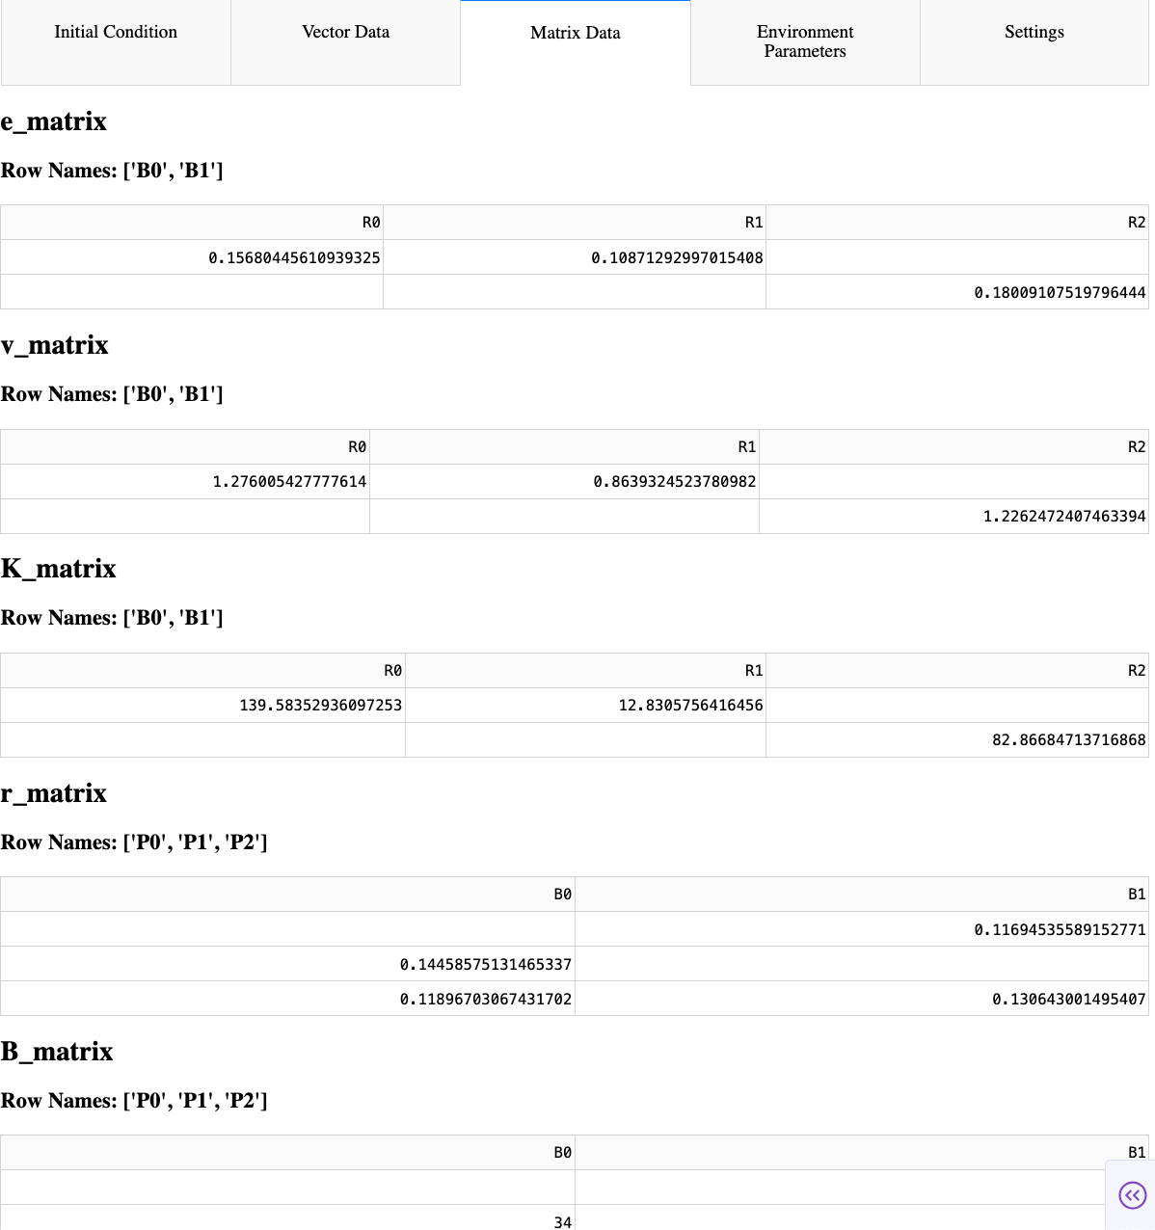
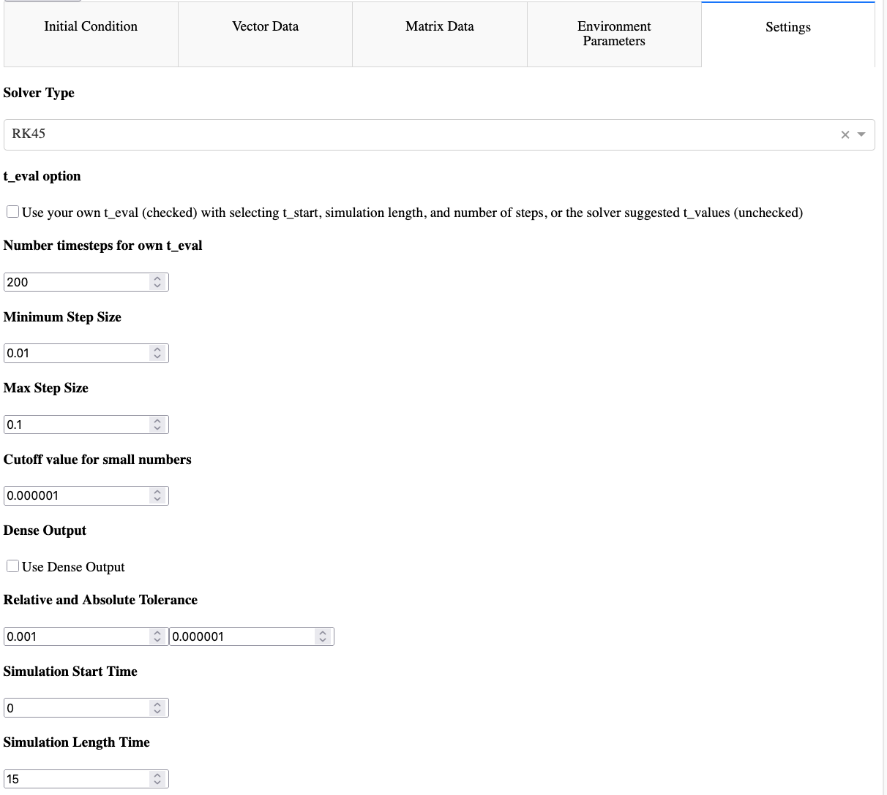
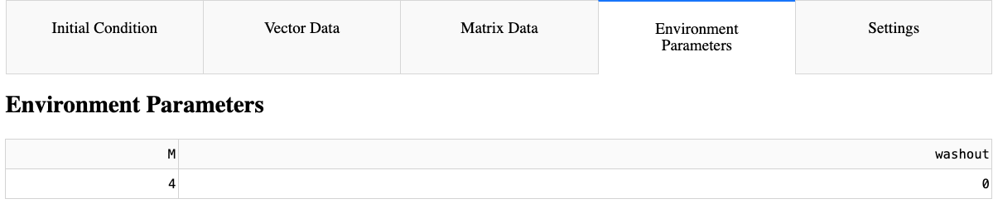
Other Editable Sections

Slide 22
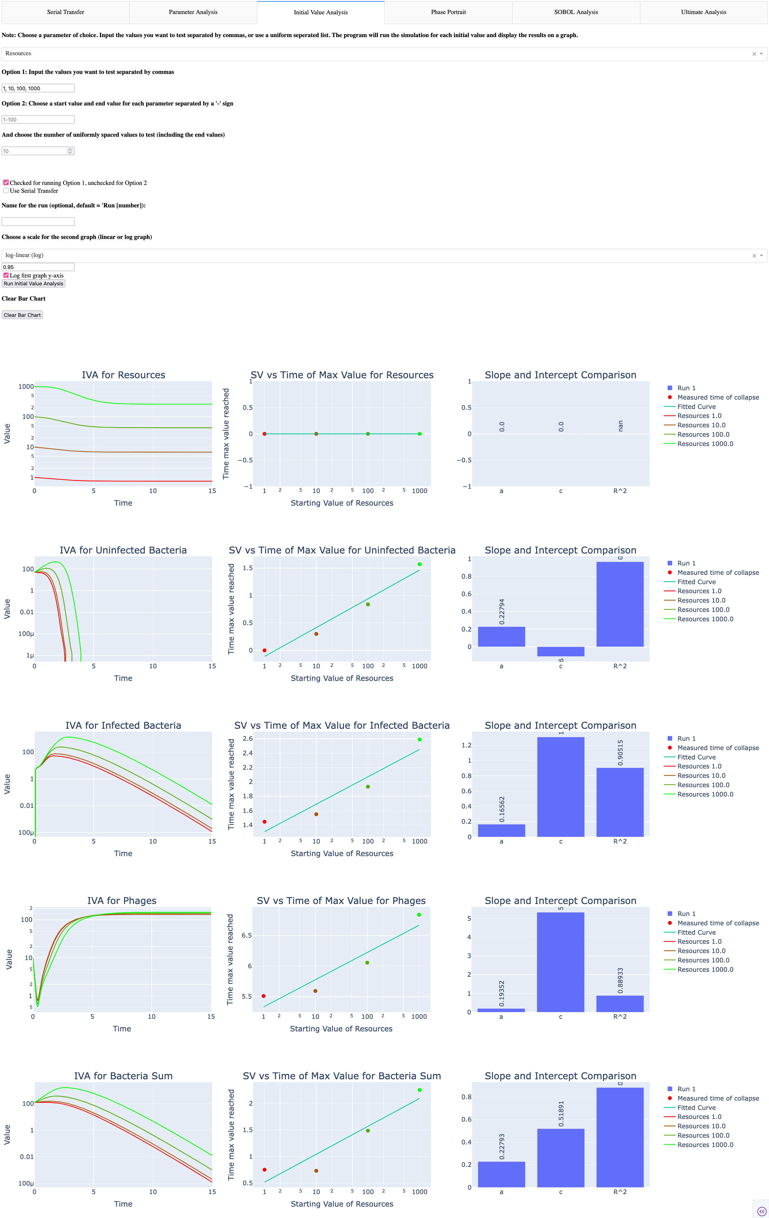
Dashboard - Advanced Analysis

Slide 23
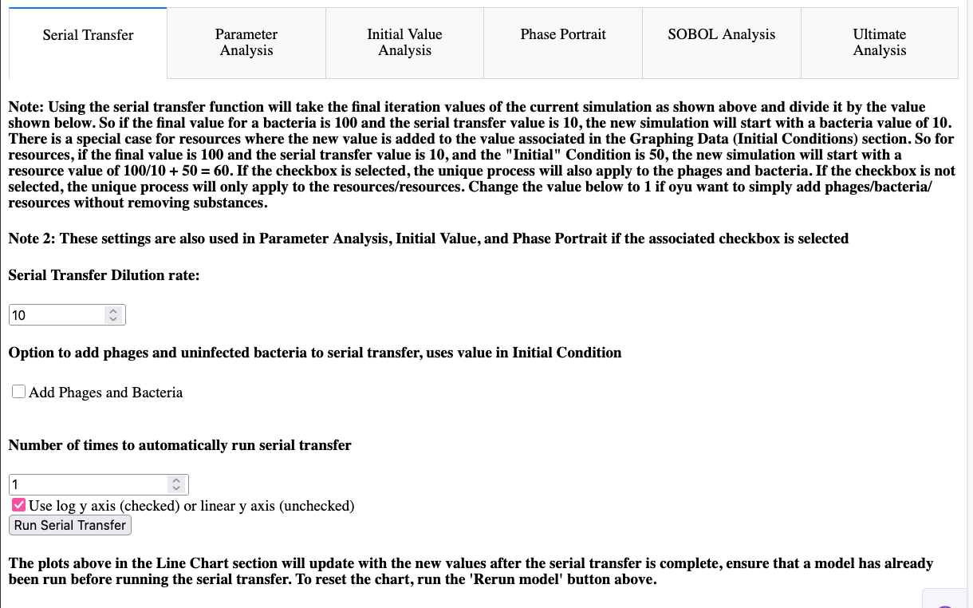
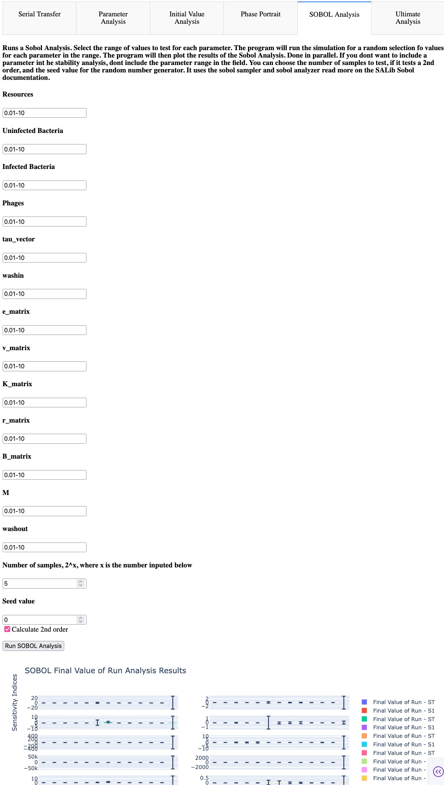
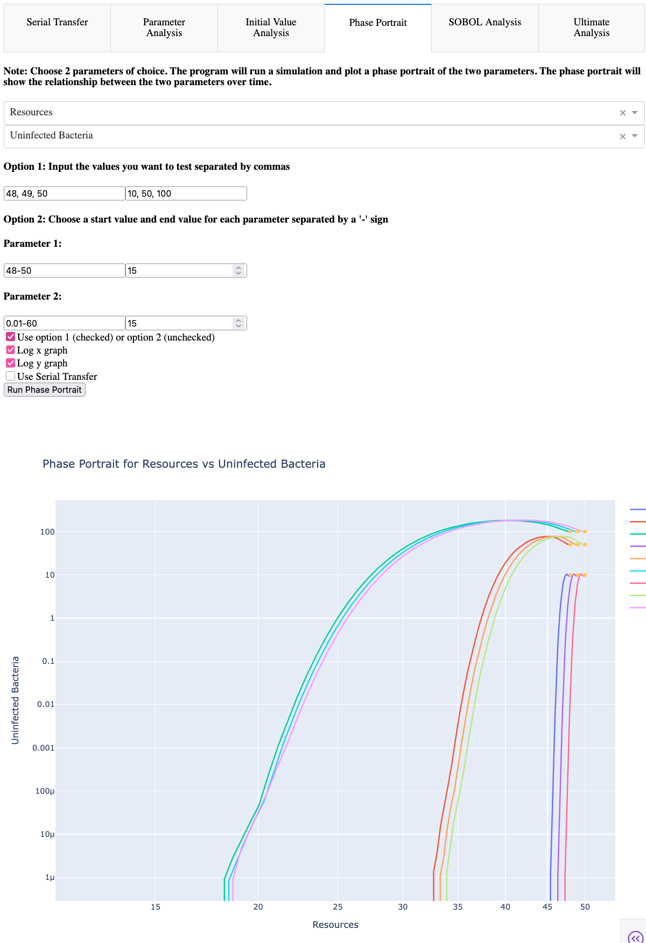
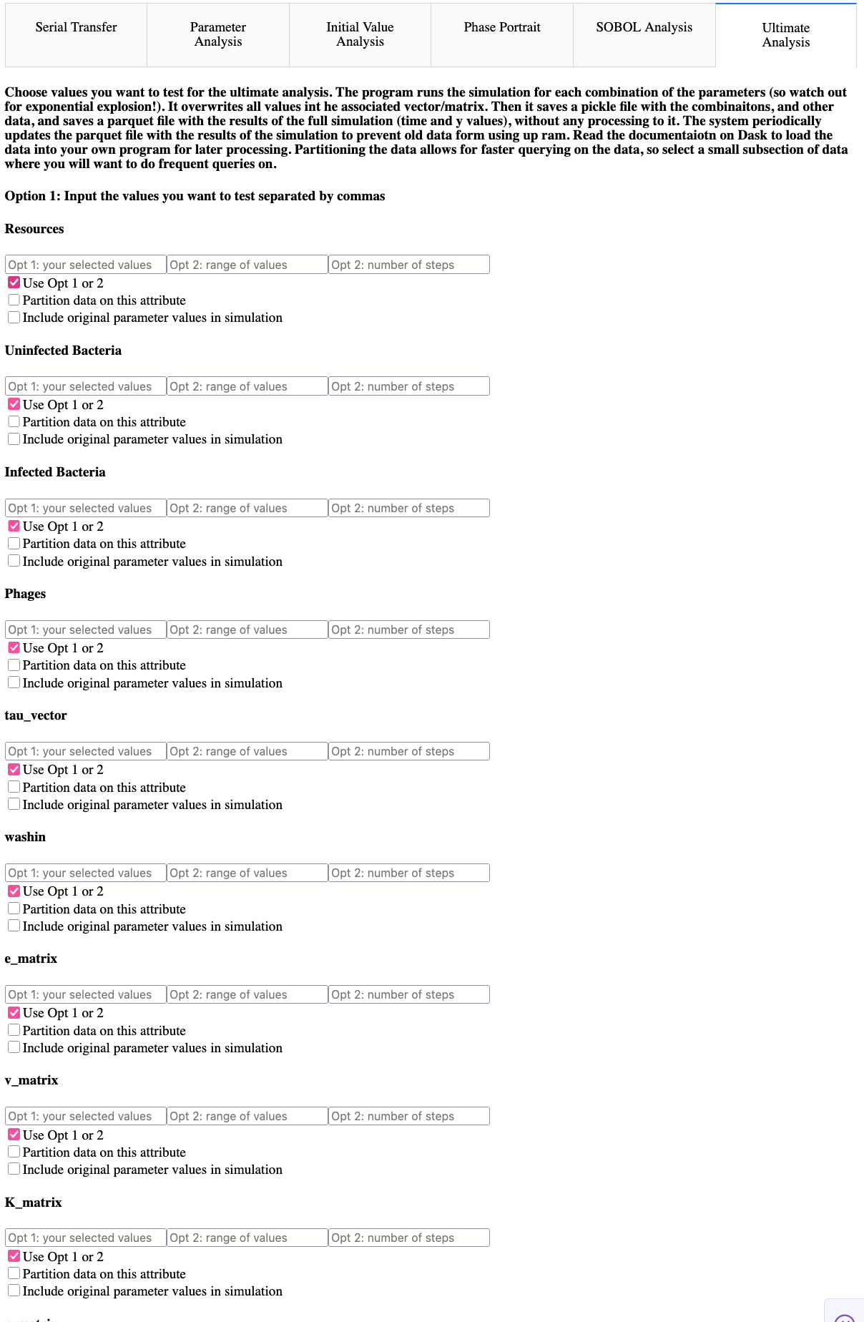
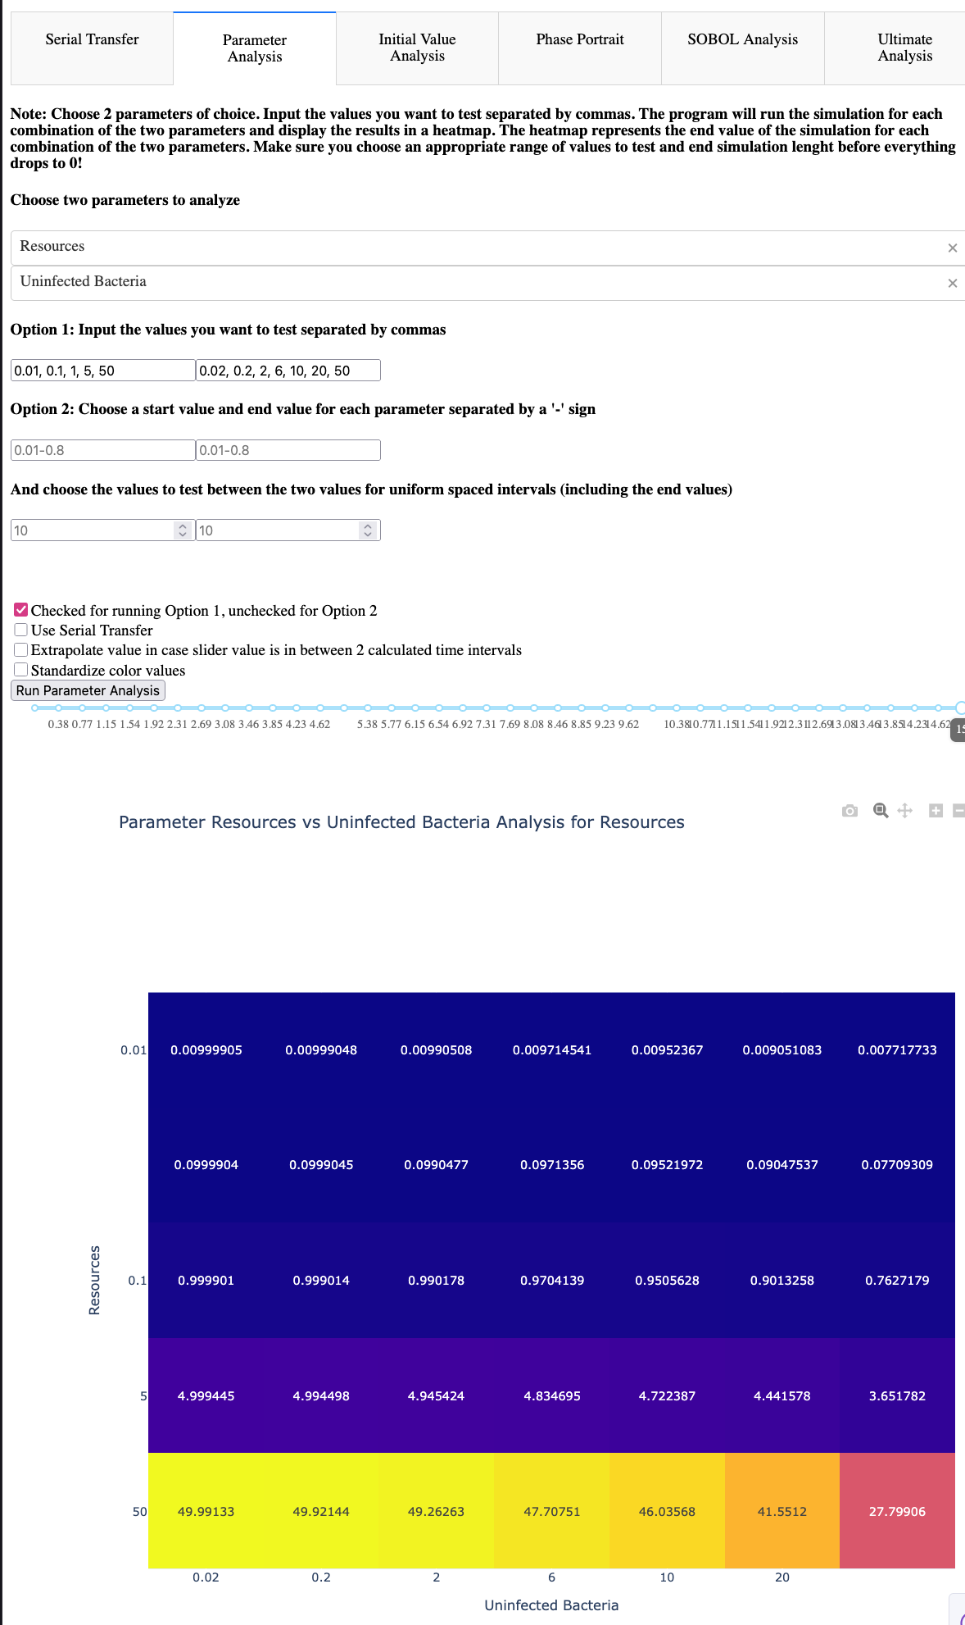
Other Advanced Analyses

Slide 24
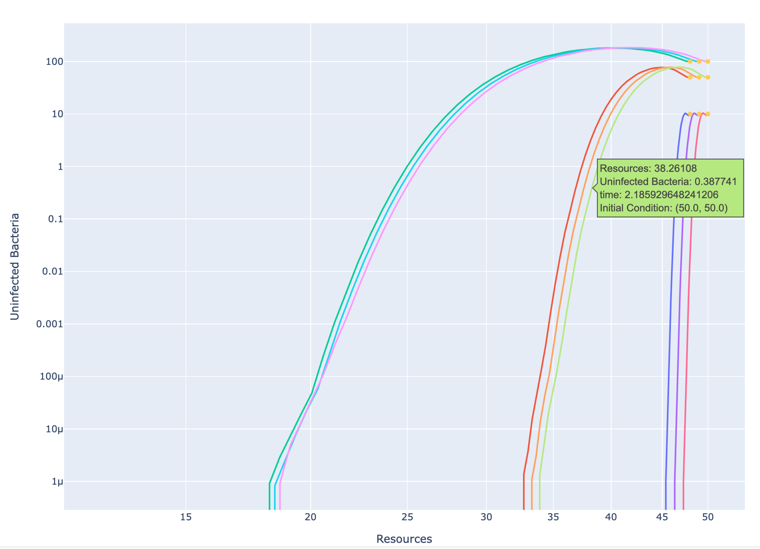
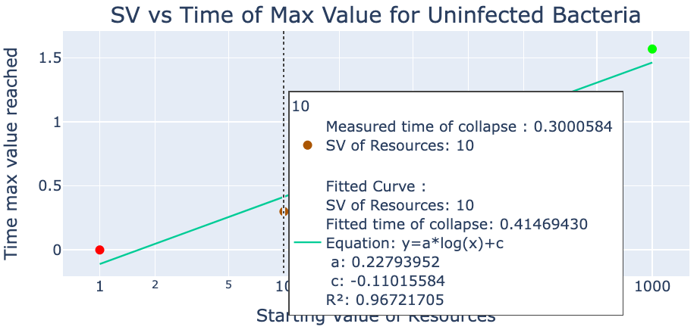
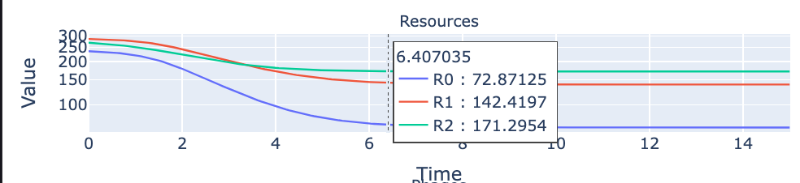
Dashboard - Interactivity

Slide 25
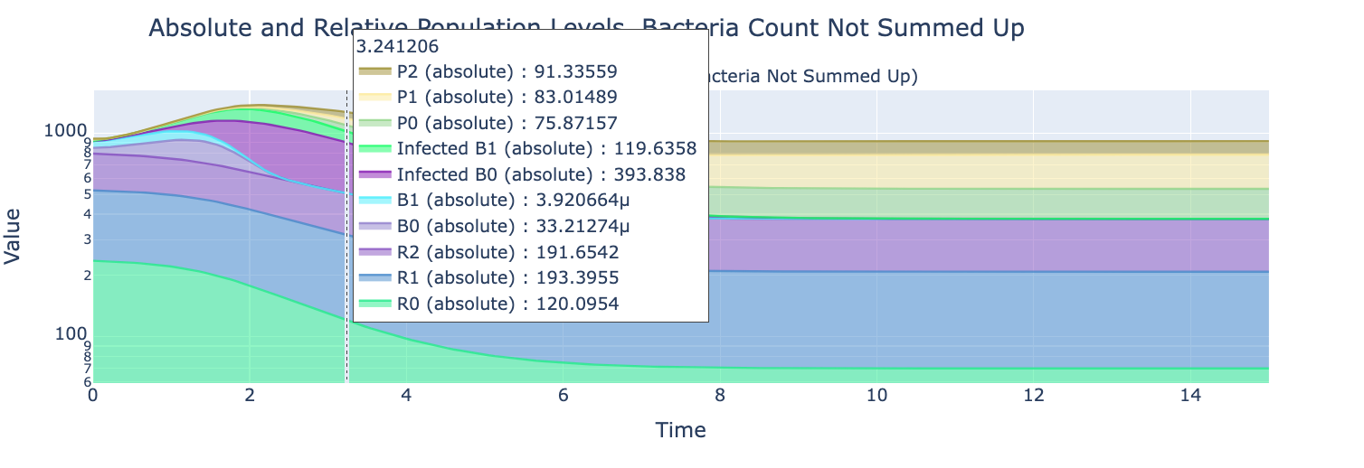
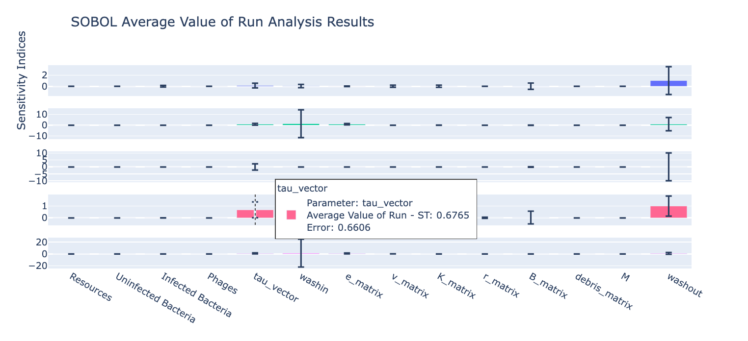
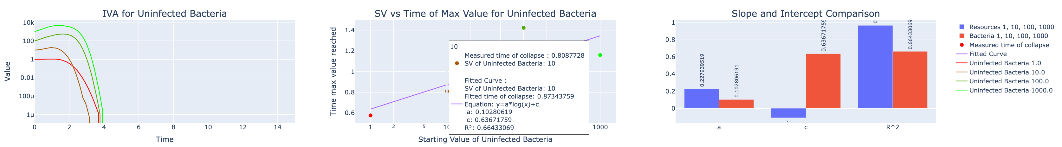
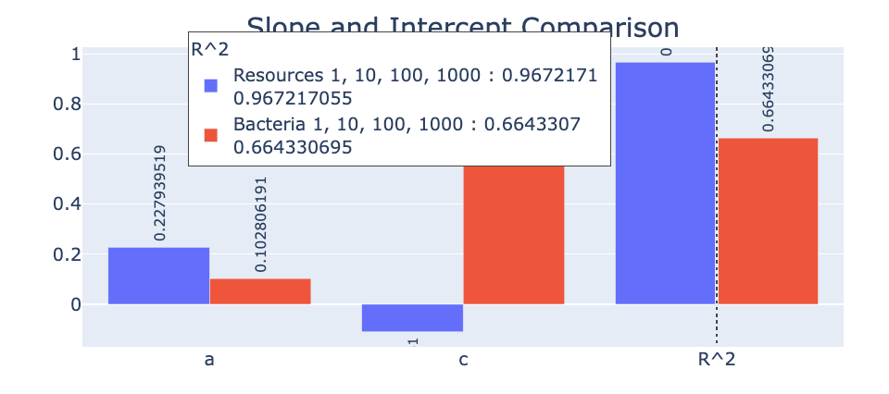
Other Interactivity

Slide 26
Small GUI and Dashboard Demo

Slide 27
04
RESULTS
COLORFUL PLOTS AND LINES!

Slide 28



01
02
SOBOL
INITIAL VALUE ANALYSIS
04
05
3x2x3 MODEL
20x20x10 Model
03
PHAGE PROLIFERATION
PARAMETER SENSITIVITY
CHANGING VALUES
GRAPH BEHAVIOR
DO NOT DIE OUT!
COMPARING BEHAVIOR
SURVIVABILITY MATRIX

Slide 29
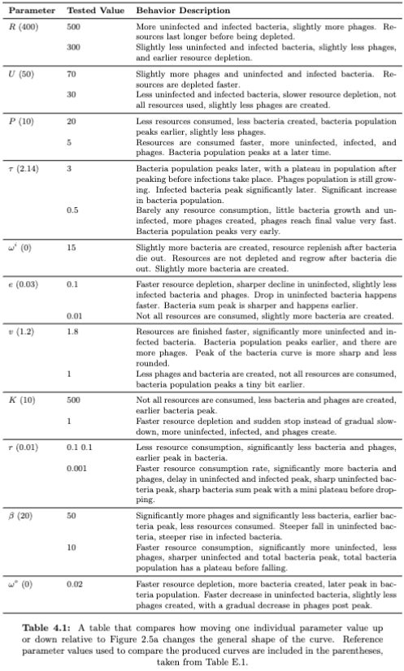
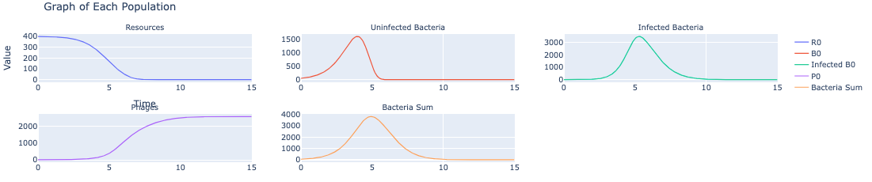
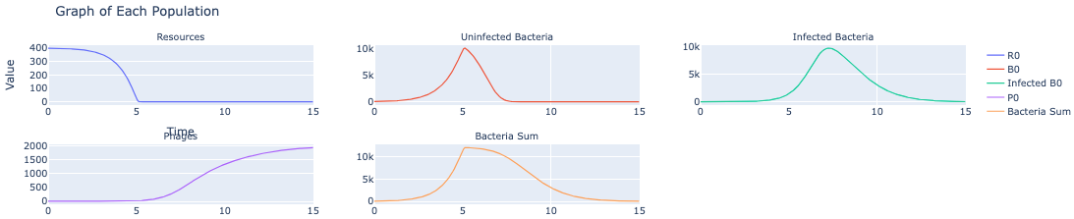
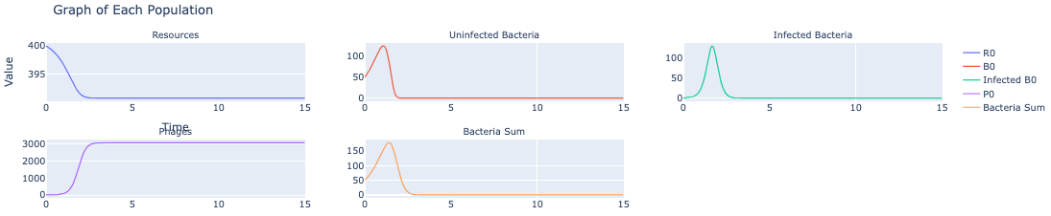
Graph Behavior - Biologist POV
Tau = 2.14 (reference graph)
Tau = 3 (slower latent time)
“As I increase tau, the latent period increases, which means it takes longer for the phages to burst, so … ”
Tau = 0.5 (faster latent time)

Slide 30
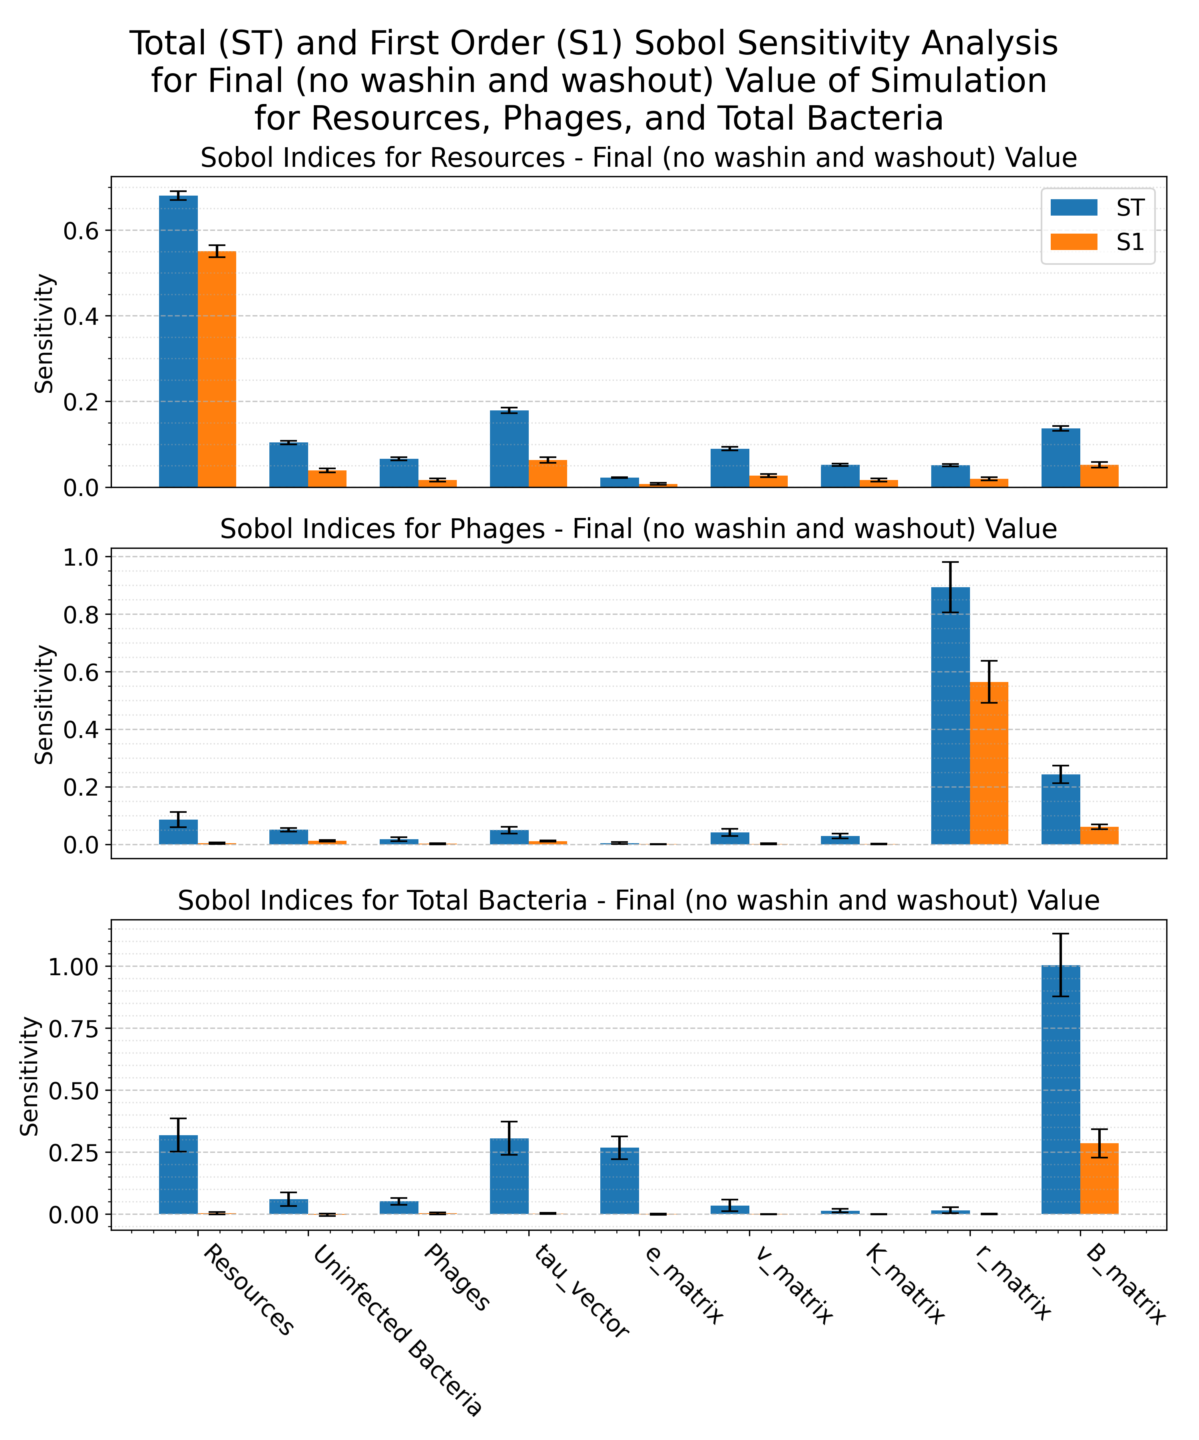
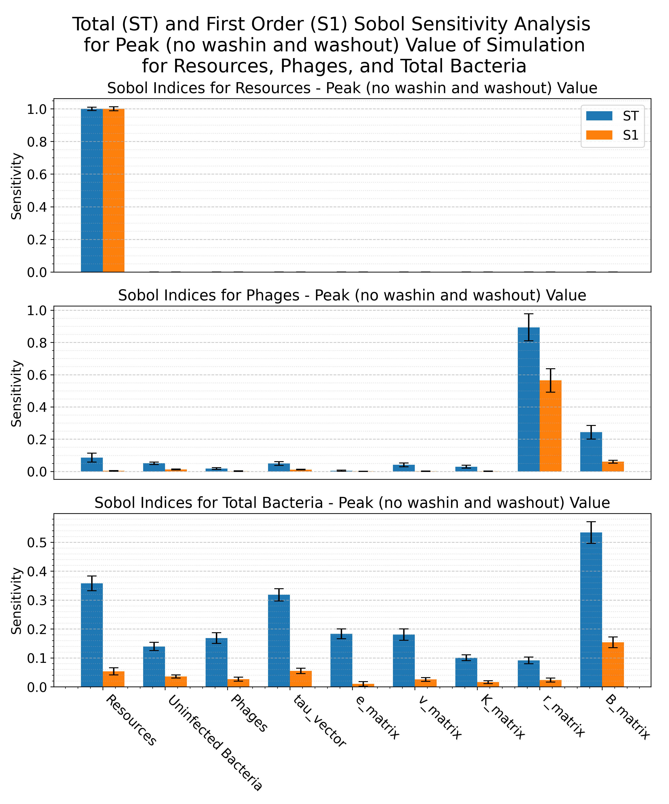
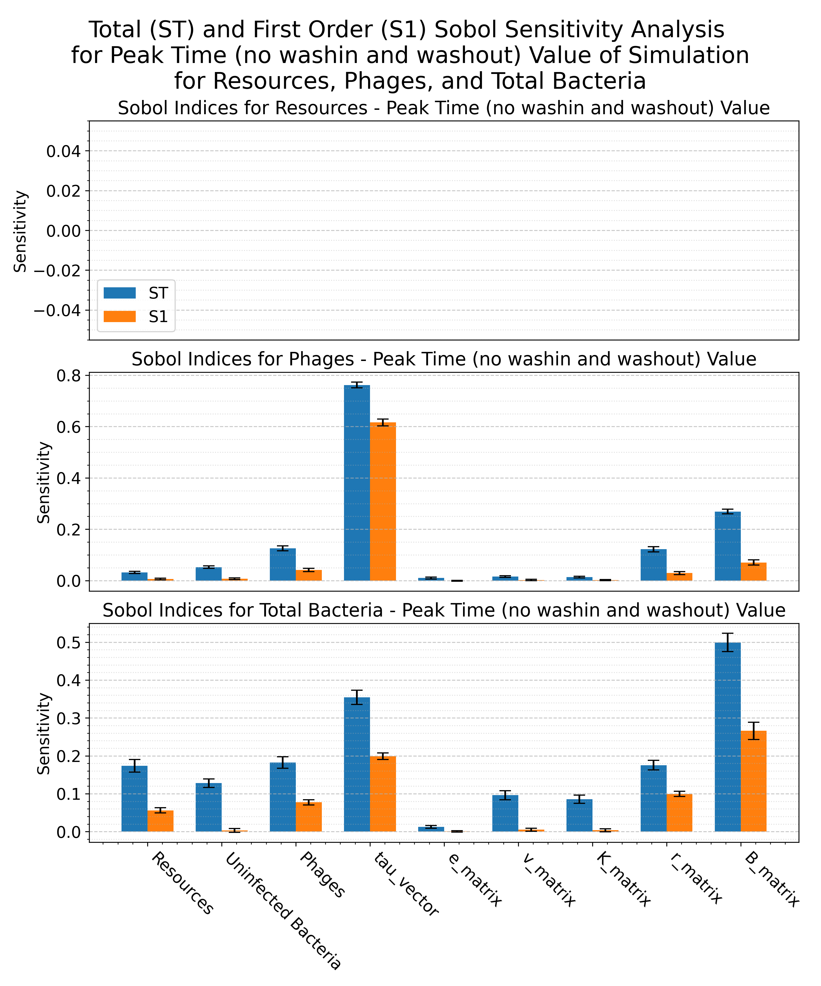
Graph Behavior – Computational Scientist POV
“I don’t know what happens if I increase tau, but I see that it greatly affects the phage peak value … ”

Slide 31



Graph Behavior – Computational Scientist POV

Slide 32
Biologist POV + Computational Scientist POV =
Greater understanding than just individually!

Slide 33
Combined Understanding
Tau = 2.14 (reference graph)
Tau = 3 (slower latent time)
Tau = 0.5 (faster latent time)
“I see that tau does not significantly affect peak value, but rather the time of peak. I know this because tau mainly affects the time to burst, so more phages are created earlier, causing a faster rise in population growth, which … ”

Slide 34
05
ANALYSIS AND CONCLUSIONS
BIGGEST TAKEAWAYS

Slide 35



Next Steps
CODE
LAB
MODEL
Documentation + Code Cleanup
Ready to Use Code Samples
New tools and features
Compare Lab Data to Model Data
Create Custom ODE Model for the Lab
Replicate Environmental and Lab Data
Fine-tune model parameters and equation
Compare different model outputs
Adapt or create new models (debris term)

Slide 36
BIBLIOGRAPHIC REFERENCES
AUTHOR (YEAR). Title of the publication. Publisher
AUTHOR (YEAR). Title of the publication. Publisher
AUTHOR (YEAR). Title of the publication. Publisher
AUTHOR (YEAR). Title of the publication. Publisher
AUTHOR (YEAR). Title of the publication. Publisher
AUTHOR (YEAR). Title of the publication. Publisher
AUTHOR (YEAR). Title of the publication. Publisher
AUTHOR (YEAR). Title of the publication. Publisher
AUTHOR (YEAR). Title of the publication. Publisher

Slide 37
THANK YOU

